Slide 1

Recurrent Neural Networks (RNNs)

Slide 2
Recurrent Neural Networks (RNNs)
A Recurrent Neural Network (RNN) is a type of artificial neural network designed for sequential or time series data, commonly applied in tasks like language translation, natural language processing (NLP), speech recognition, and image captioning. Unlike traditional neural networks, RNNs have a "memory" that considers prior inputs to influence current input and output, making them suitable for tasks where order matters. They share parameters across layers, contrasting with feedforward networks, and use backpropagation through time (BPTT) for gradient determination, addressing sequence-specific challenges. However, RNNs face problems like exploding and vanishing gradients, impacting learning.

Slide 3
Application of RNNs
Applications of Recurrent Neural Network:
- Natural Language Processing (NLP)
- Speech Recognition
- Time Series Analysis
- Image and Video Captioning
- Fraud Detection

Slide 4
RNN VS CNN
Aspect | CNN | RNN
Data Type | Structured grid data | Sequential or time-series data
Architecture | Layered structure with convolutional and pooling layers | Layered structure with recurrent layers
Memory | Limited local context due to convolutional filters | Long-range temporal dependencies due to hidden state
Training | Backpropagation with gradient descent | Backpropagation through time (BPTT)

Slide 5
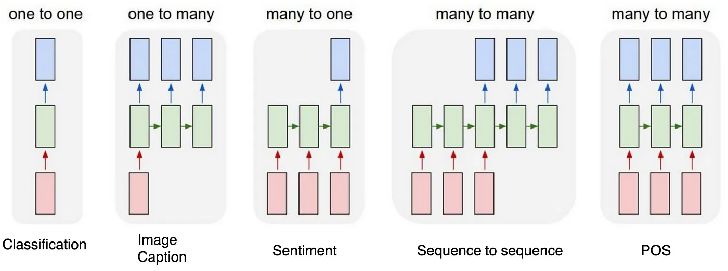
Types of RNN Architecture
- One to One: It is also known as vanilla neural network. It is used for basic machine learning problems.
- One to Many: It has single input and many outputs.
- Many to One: It has many inputs and a single output. This is basically used in analyzing sentiments, where we give a sentence as an input and get sentiment regarding that as output.
- Many to Many: It takes a sequence of inputs and generate a sequence of outputs.

Slide 6
Challenge of RNNs
Challenge:
- Fixed Input Size: Neural networks expect inputs of a consistent size.
Implication:
- Handling Variability: Need a mechanism to handle sequences of different lengths.

Slide 7
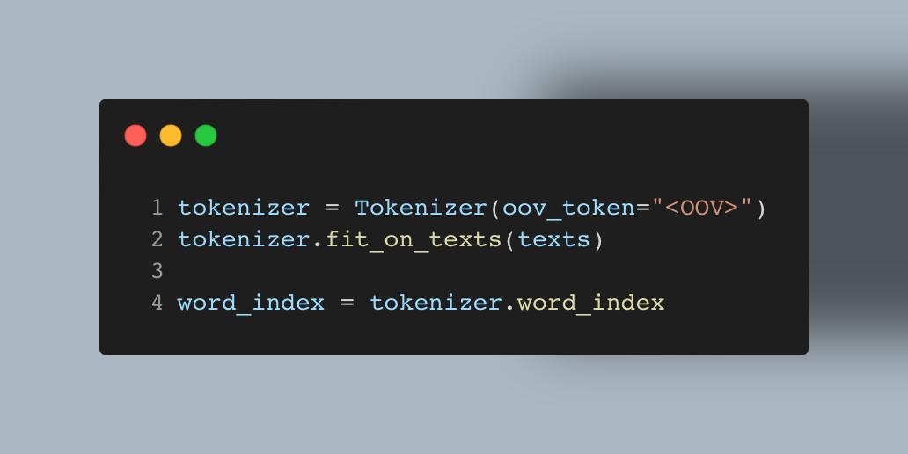
Tokenization
- Tokenization: The process of breaking down text into smaller units called tokens (words or subwords).
- Example:
Text: " Deep learning is fascinating."
Tokens: [“<OOV>”, "Deep", "learning", "is", "fascinating”, “.”]
Text: ”Machine learning is amazing."
Tokens: [“<OVV>”, "Deep", "learning", "is", "fascinating”, “.”, ”Machine”, ”amazing”]

Slide 8
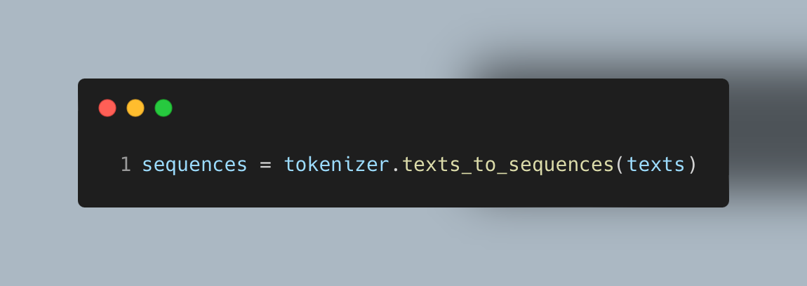
Text to sequence
- Text to Sequence: Converting a sequence of words into a sequence of integers.
- Example:
Text: ”Deep learning is fascinating."
Text to Sequence: [1, 2, 3, 4, 5]
Text: "Machine learning is amazing."
Text to Sequence: [6, 2, 3, 7, 5]
Text: ”AI is amazing."
Text to Sequence: [0, 2, 7, 5]

Slide 9
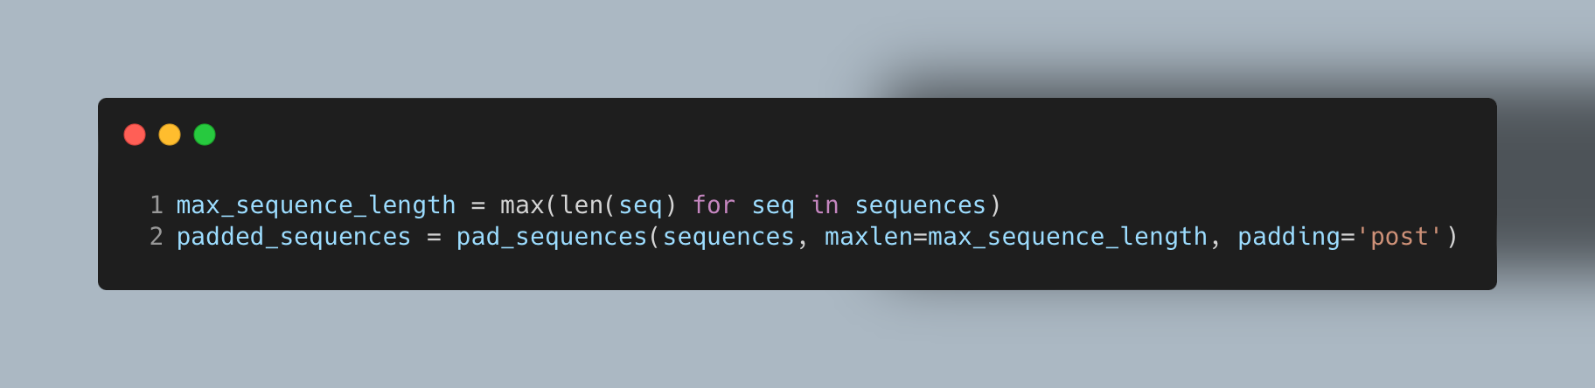
Pad sequence
Challenge:
- Variable Lengths: Text sequences may have different lengths.
Solution:
- Padding: Add zeros (or another specified value) to make all sequences equal length.
- Padding Sequence: Ensures consistent input size for neural networks.
Example:
- Original Sequence: [1, 2, 3, 4, 5]
- Post Padded Sequence: [1, 2, 3, 4, 5, 0, 0]
- Pre-Padded Sequence: [0, 0, 1, 2, 3, 4, 5,]

Slide 10
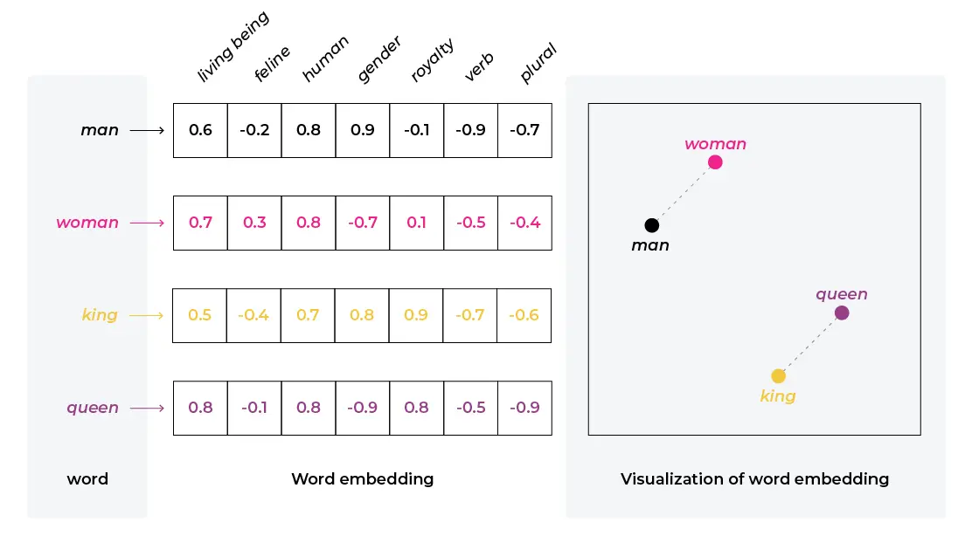
Embedding Layer
Embedding Layer: Transforms integer indices into dense vectors in a continuous vector space.
Training:
Learnable Parameters: Adjusted during model training to capture semantic relationships.
Example:
Integer Sequence: [1, 2, 3, 4, 5]
Embedding Vectors: [0.12, -0.45, 0.67, 0.98, 0.32]

Slide 11
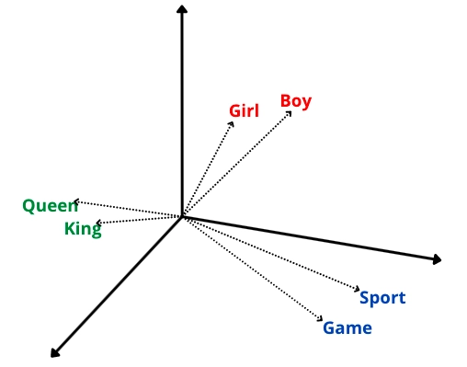
Embedding Layer

Slide 12
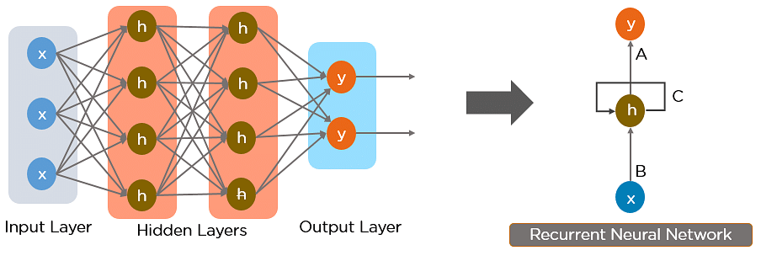

Recap: How ANNs/DNNs works
$$h_{t}=f(x_{t})$$

Slide 13
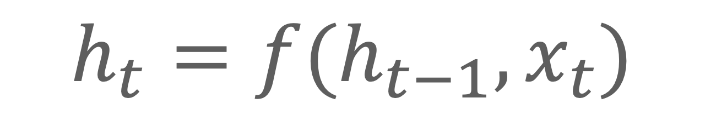
Explain How RNNs works
$$h_{t}=f(h_{t−1}, x_{t})$$

Slide 14
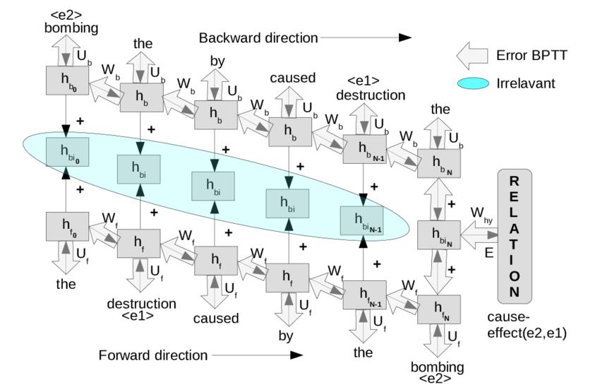
Backpropagation Through Time (BPTT)
Backpropagation Through Time (BPTT):
Training an RNN involves using the backpropagation algorithm extended through time (BPTT). It's a variant of backpropagation that takes into account the sequential nature of the data.

Slide 15
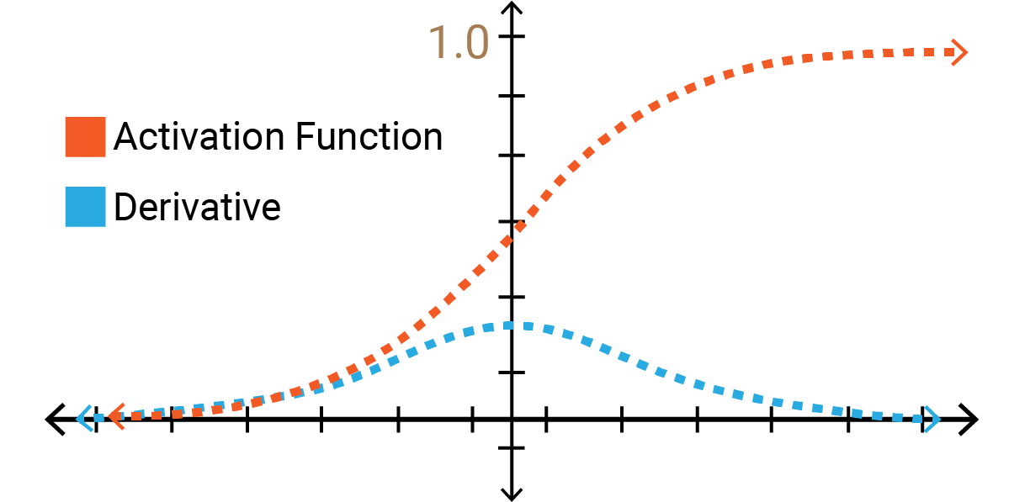
Vanishing and Exploding Gradients
One challenge with RNNs is the vanishing and exploding gradient problem. Gradients can become very small or very large during training, making it difficult for the network to learn long-term dependencies. Techniques like gradient clipping and more advanced architectures (e.g., LSTM and GRU) are used to address these issues.

Slide 16
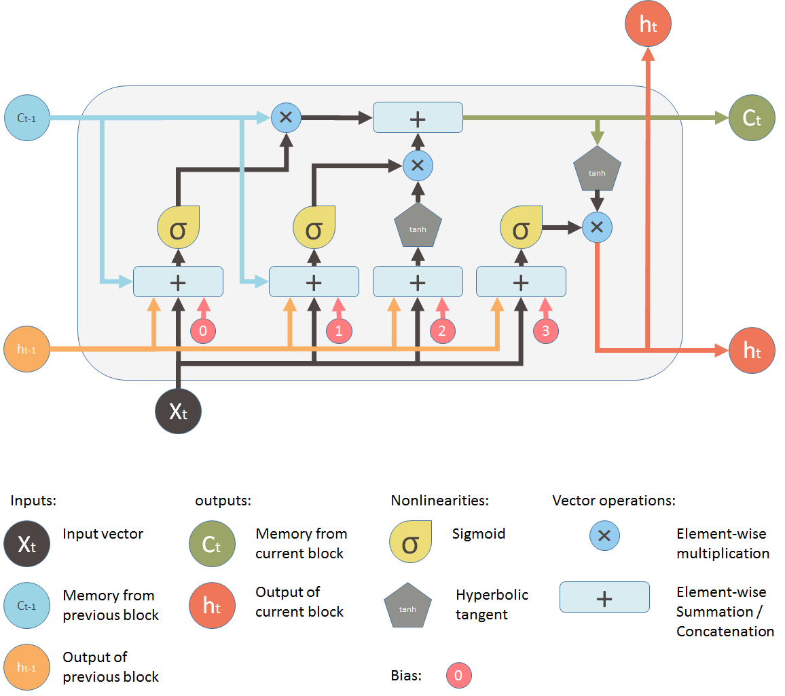
LSTM (Long Short-Term Memory)
LSTM and GRU are specialized RNN architectures designed to address the vanishing gradient problem by incorporating mechanisms to selectively remember and forget information.

Slide 17
Advantages of RNNs
Disadvantages of RNNs
- RNNs can handle any length of input.
- RNNs model designed to remember each piece of information forever, which is extremely useful in any time series prediction.
- The model size does not increase as input size grows.
- The computation is slow due to its recurrent nature.
- RNNs models can be challenging to train.
- problem like exploding and gradient vanishing are common.

Slide 18
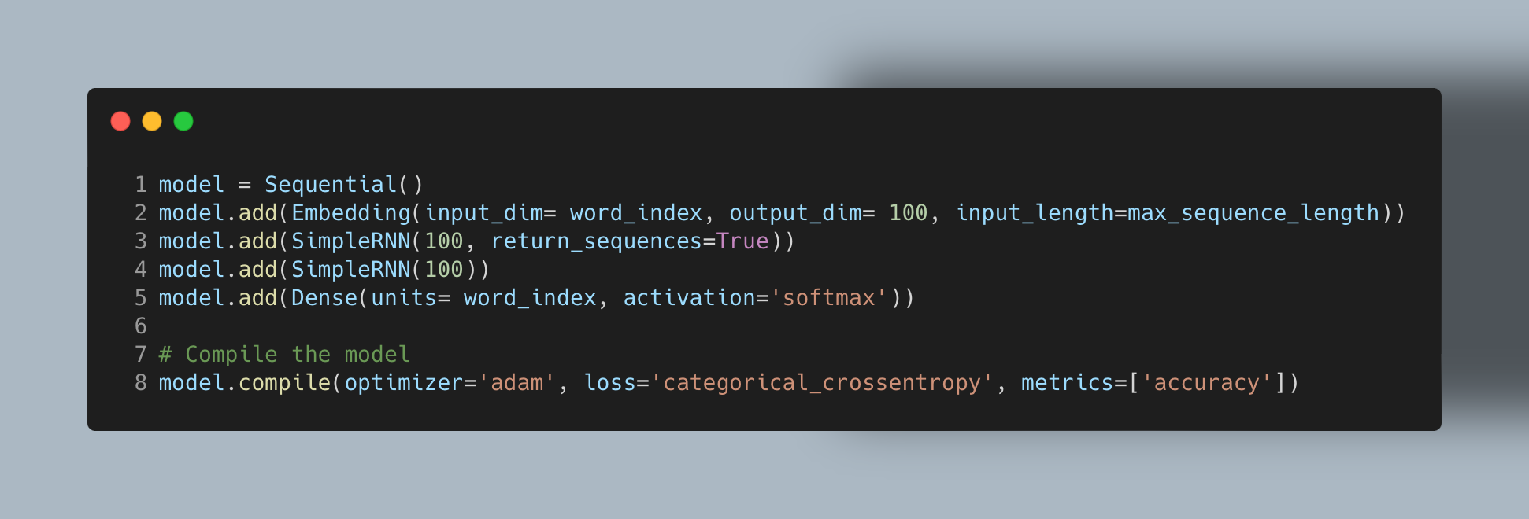
Building a code RNN

Slide 19
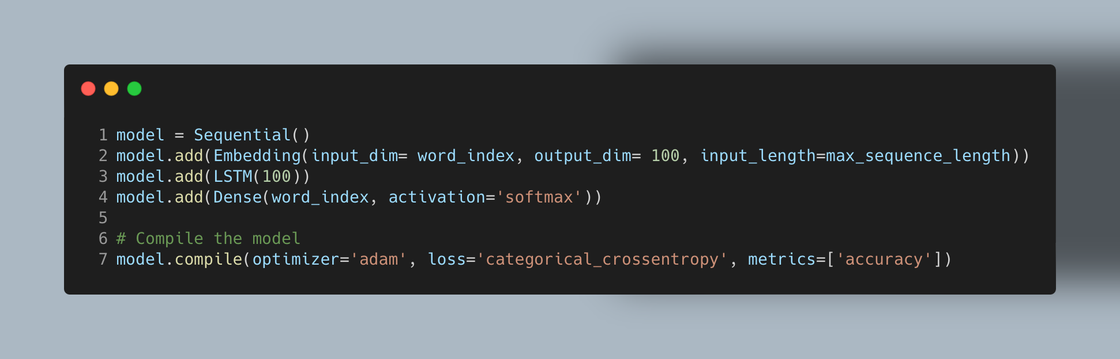
Building a code LSTM

Slide 20
Resources
Neural Networks from Scratch in Python, Harrison Kinsley & Daniel Kukieła.
Neural Networks and Deep Learning, Charu C. Aggarwal.
grokking Deep Learning, Andrew W. Trask.
Activation Functions In Neural Networks – Its Components, Uses & Types

Slide 21
Thank You

